Slide 1
KERALA KUDUMBASREE UNIT AUTOMATION
Guide : Presented by
Santhosh kottam ANAGHA M U

Slide 2
Introduction
Women Empowerment in Kerala is usually known as “Kudumbashree”. Kudumbashree is an innovative initiated to which engendering development in Kerala is formed with a view to help the poverty-stricken people to take initiative for a practical solution to poverty.
It also aims at women empowerment, increasing in the income of women fellowship, appointment, women and child, social development etc.
The project is a mobile application for Kudumbashree unit. The principle of the system is that the details of Kudumbashree is stored in computer system.
By using this system, any user can easily take the details of the Kudumbashree. It may be adding report, meeting, loan, actvities details etc.
This application generates report both monthly and weekly and saves our time.

Slide 3
RELEVENCE OF THE TOPIC
This project is very useful for the people. The system is very secure than the old system. It saves money of the people as they do not need to travel to no many things. About there loan report etc.

Slide 4
objectives
The project objective is to make the jobs of Kudumbashree units under a Panchayath more easier and work without any hindrances of those jobs were done manually currently. This takes more time and hard work.
This project can overcome all the problems of admin duties and the data will be safe and secured.

Slide 5
EXISTING SYSTEM
The current system is time consuming
Low processing speed.
There is a chance of redundancy.
Current system does not provide any security.

Slide 6
PROPOSED SYSTEM
Making searching and updating very easy.
User friendly.
Help to make well formatted reports.
Reduce work load of women.
Reduce complexity of manual calculations.
Better security provides.

Slide 7
MODULES
User management
it contains registration and login for users ,president, members and admin can add, update ,delete all the details.
Loan management
user request for the loan and president approves the loan if the person is eligble.then the user get a notification from the president.
Event scheduling
president schedules the meeting date and update the users

Slide 8
Software requirements
Web Server : Xampp
Front End : Android
Back End : MySQL, PHP
IDE : Android Studio

Slide 9

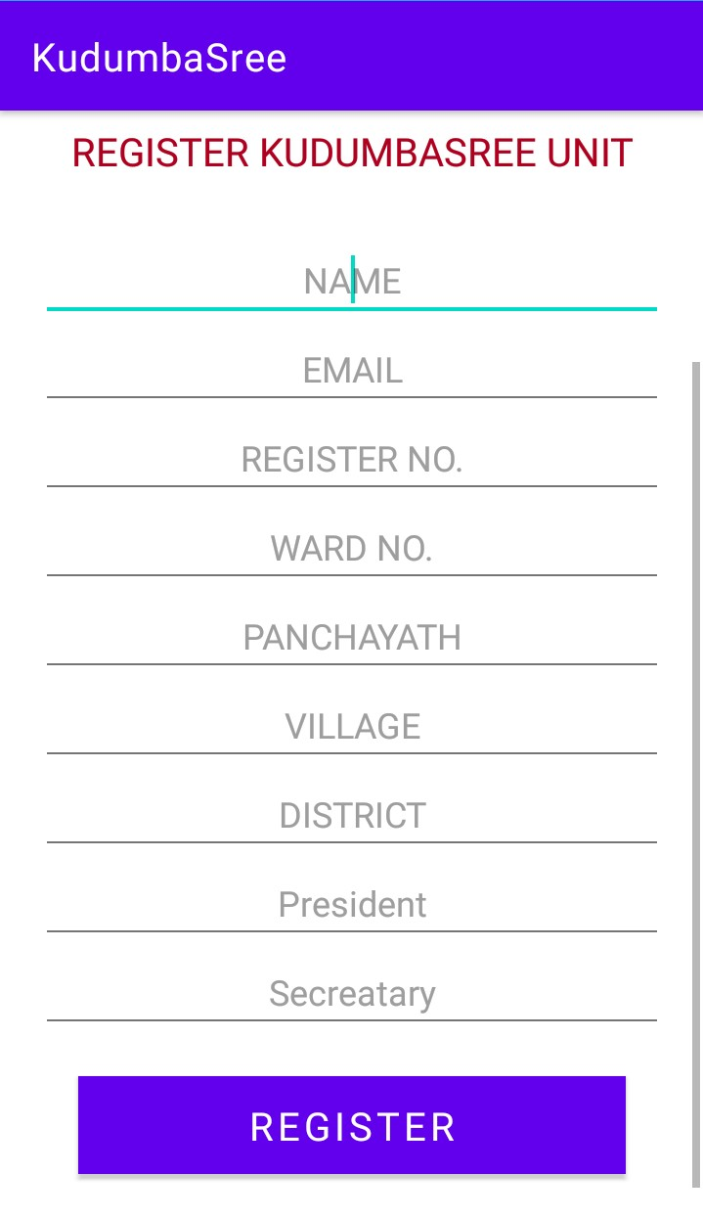
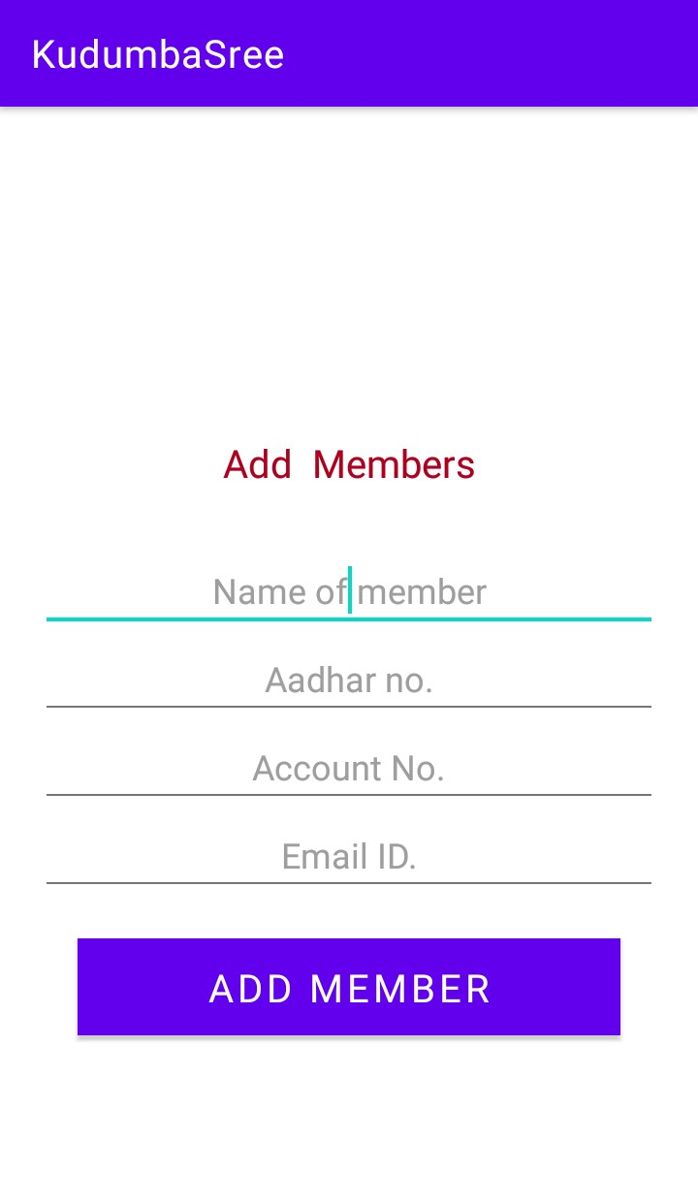
SCREENSHOTs

Slide 10
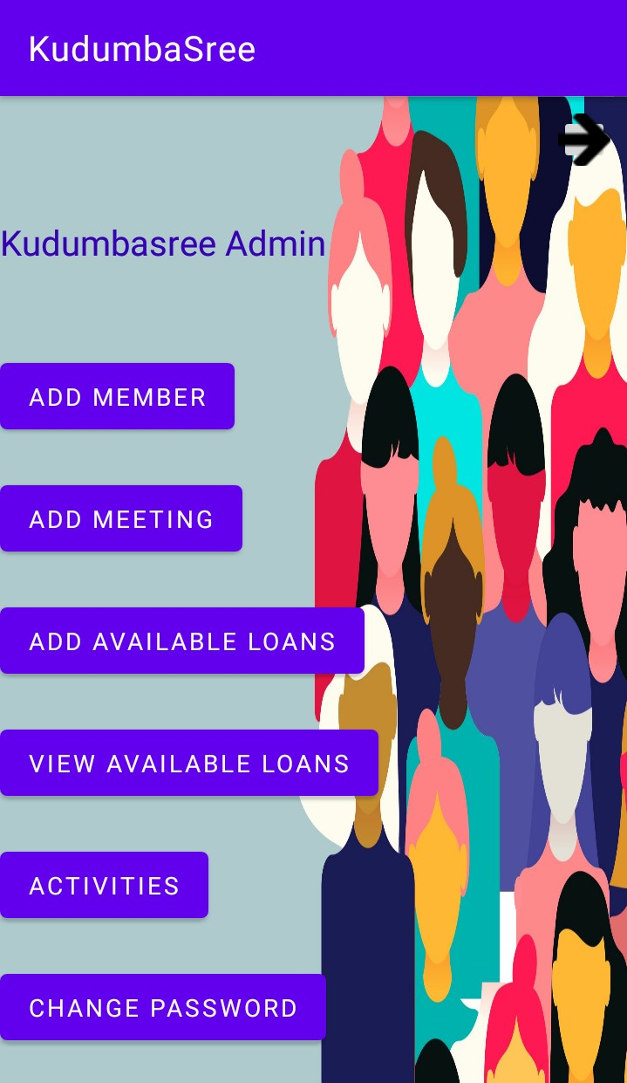
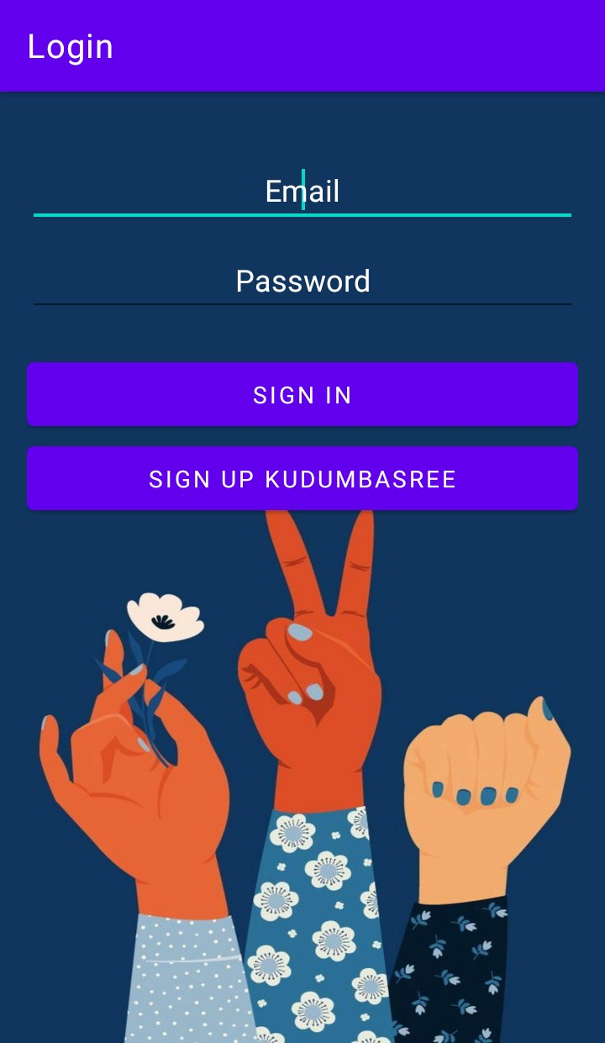
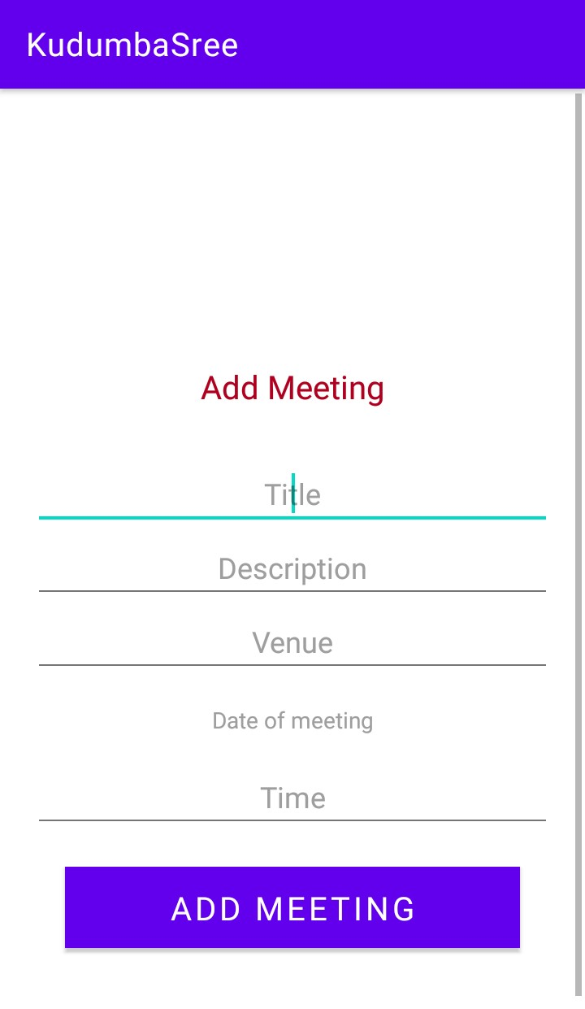
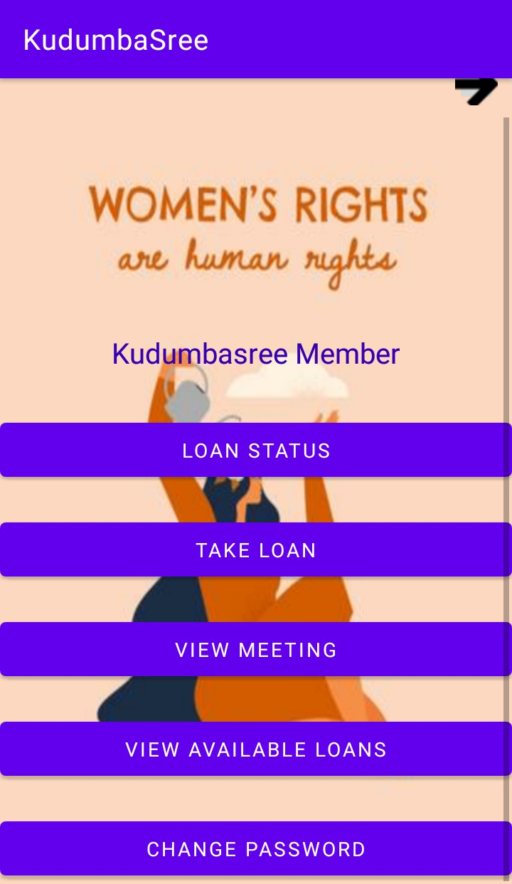

Slide 11
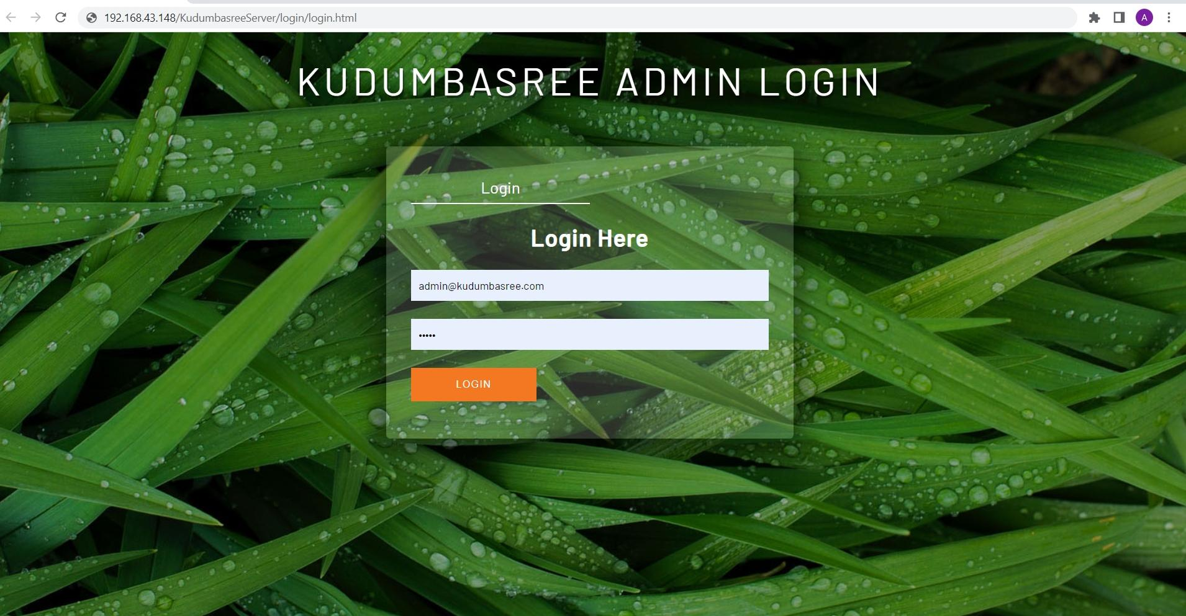

Slide 12
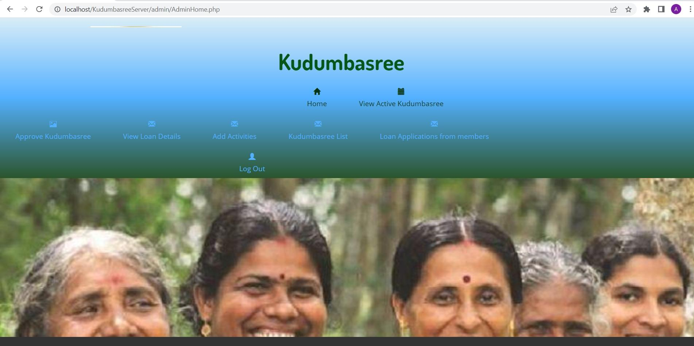

Slide 13
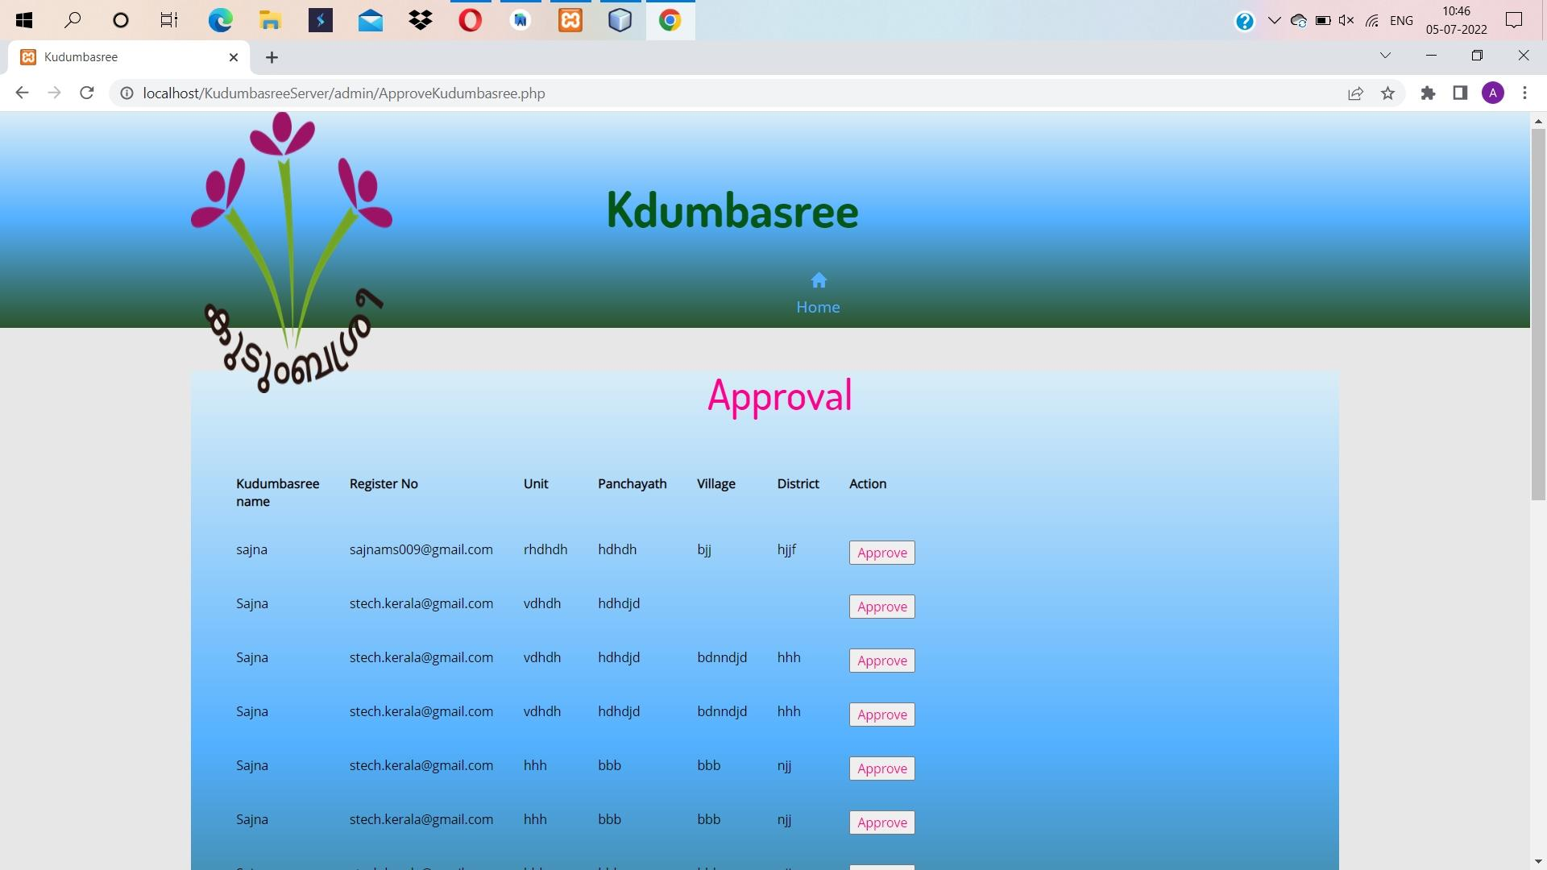

Slide 14
THANK YOU

